Slide 1




Retail Sales Data Analysis
Data Analysis Using Python,SQL and PowerBI

Slide 2

Step 1: EDA Using Python
EDA stands for Exploratory Data Analysis. It is a key step in the data analysis process, used to understand the structure, quality, and patterns within a dataset before applying modeling or machine learning techniques.
Library used to perform the EDA-Pandas,Matplotlib,Seaborne.
Pandas is a library used to visualize csv files ,SQL tables.
The name "Pandas" comes from "Panel Data", a term used in econometrics.
Built on top of NumPy, it provides high-performance data structures and operations for handling tabular data (like spreadsheets or SQL tables).

Slide 3
Some Functions used in Python Pandas for EDA
pd.read_csv('../retail_data.csv’) –used to read
data.shape-returns shape
data.head()-returns first five rows
data.info()-returns info
data.describe()-returns description
data.isnull().sum()-returns all null values
data.duplicated().sum()-returns all duplicate values
data.nunique()-returns unique values

Slide 4
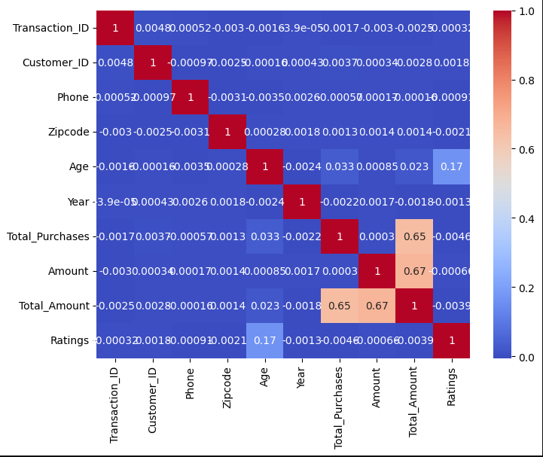
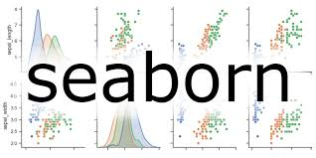
Visualizing Data correlation
plt.figure(figsize=(8,6))
sns.heatmap(data.corr(numeric_only=True),cmap='coolwarm')
plt.show()

Slide 5
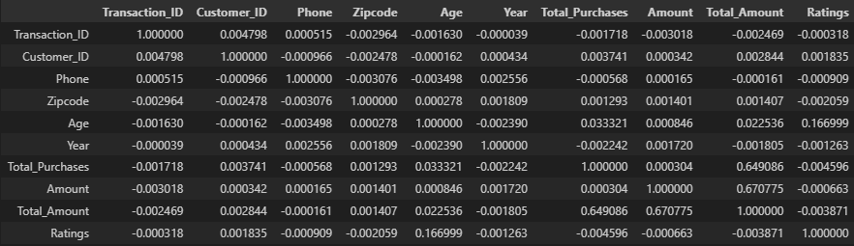
EDA on retail sales data (Some basic points)
Shape of given data-30210 rows , 30 columns
There are 4 duplicated rows
Null values in total- 8370
Unique values-2,008,754
Correlation –

Slide 6
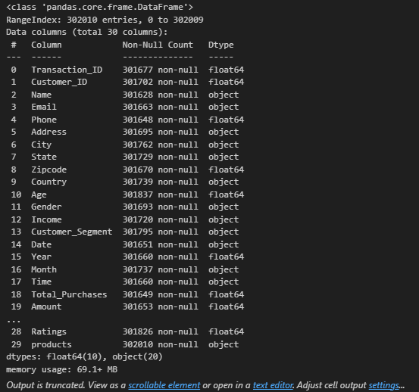
EDA on retail sales data
info

Slide 7
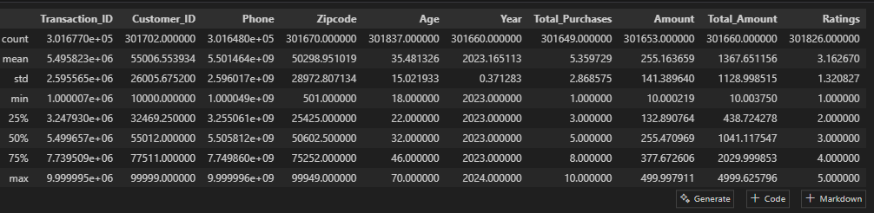
EDA on retail sales data
Description-

Slide 8
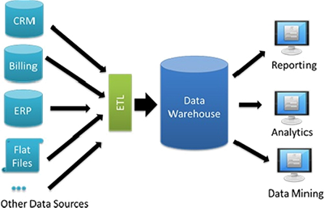
Data Warehousing
A Data Warehouse is a centralized repository that stores large volumes of structured data from different sources, optimized for reporting, analysis, and decision-making.
The Medallion Architecture is a modern data engineering pattern used in data lakehouses (e.g., with Databricks, Delta Lake, or similar platforms). It organizes data into three layers: Bronze, Silver, and Gold—like medals—to improve data quality, scalability, and performance.

Slide 9
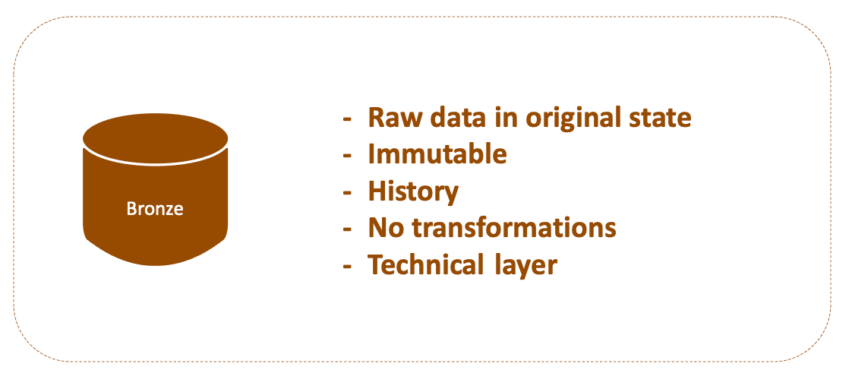
Bronze Layer
Challenges Incurred during retail sales data analysis bronze stage-
1)Choosing an appropriate datatype for each column
2)Choosing lengths for all string type columns
The primary error was handling the encoding error.
The encoding of the characters was of the type ‘utf-8’
Encountered error:
Msg 4864, Level 16, State 1, Line 1 Bulk load data conversion error (type mismatch or invalid character for the specified codepage) for row 1, column 1 (TRANSACTION_ID).
Caused due to
BULK INSERT BRONZE.RETAIL_SALES_DETAILS
FROM 'C:\Data\retail_sales.csv'
WITH (
FIRSTROW = 2,
FIELDTERMINATOR = ',',
ROWTERMINATOR = '\n',
TABLOCK
);

Slide 10
Bronze Layer
The error was fixed by
BULK INSERT BRONZE.RETAIL_SALES_DETAILS
FROM "C:\Users\vishw\OneDrive\Desktop\projects\EYproject\retail_data.csv"
WITH(
FIRSTROW=2,
FORMAT='CSV',
FIELDTERMINATOR=',',
ROWTERMINATOR='\n',
CODEPAGE = '65001',
TABLOCK
);
SELECT * FROM BRONZE.RETAIL_SALES_DETAILS;

Slide 11
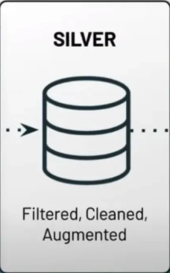
Silver layer
Challenges encountered:
Dealing with various NULL values in EVERY COLUMN
Replaced NULL with N/A in places where data could not be effectively replaced. Examples include CUST_PHONE,CUST_ZIPCODE,where data cannot be replaced without consulting sources.
Biggest issue with NULLS-Primary key
TRANSACTION_ID AND CUST_ID act as primary keys for two tables
This means they cannot be null or have duplicates

Slide 12
Silver layer
In order to fix the duplicate issues with the primary keys,we order them by transaction date and select the latest date.
WITH LatestPerTransaction AS (
SELECT *,
ROW_NUMBER() OVER (PARTITION BY TRANSACTION_ID ORDER BY TRANSACTION_DATE DESC) AS RN_Trans
FROM BRONZE.RETAIL_SALES_DETAILS
),
FilteredTransaction AS (
SELECT * FROM LatestPerTransaction WHERE RN_Trans = 1
),
LatestPerCustomer AS (
SELECT *,
ROW_NUMBER() OVER (PARTITION BY CUST_ID ORDER BY TRANSACTION_DATE DESC) AS RN_Cust
FROM FilteredTransaction
),
FilteredCustomer AS (
SELECT * FROM LatestPerCustomer WHERE RN_Cust = 1
)

Slide 13
Silver Layer
In order to fix the NULL values in the primary keys-
We assign CUST_ID to TRANSACTION_ID when TRANSACTION_ID IS NULL and vice versa
Next special case of NULL Values is the transaction dates.
In the table , transaction month and year are mentioned , but some dates are NULL.
Therefore, we build the transaction date using the available data.
Another important transformation done is TRANSACTION_TIME
The time format is converted to TIME(0)
Another transformation done is performed on floating point values.
The floating point values were rounded off to 2 decimal places.

Slide 14
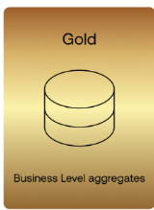
Gold Layer
The Gold Layer in a Medallion Architecture (used in data engineering and modern data warehousing, like in Databricks or traditional SQL systems) refers to the final, most refined layer of data.
The Gold Layer is used for business reporting and analytics. It:
Contains aggregated, enriched, or denormalized data.
Is designed for direct consumption by BI tools like Power BI, Tableau, etc.
Typically consists of Fact and Dimension tables in a Star Schema or Snowflake Schema.

Slide 15
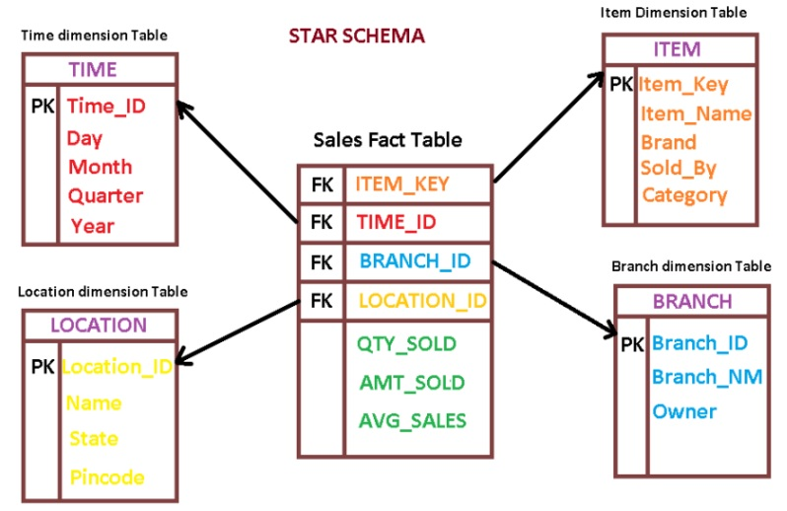
Gold Layer
In the gold layer we create Dimension and Facts
GOLD.DIM_CUSTOMER,GOLD.DIM_PRODUCT AND GOLD.FACT_SALES
We create foreign keys to link tables
CUSTOMER_ID INT FOREIGN KEY REFERENCES GOLD.DIM_CUSTOMER(CUSTOMER_ID),
PRODUCT_ID INT FOREIGN KEY REFERENCES GOLD.DIM_PRODUCT(PRODUCT_ID),
Example of a STAR schema

Slide 16
Gold Layer
We create FACT_SALES USING dimension of customer and product.
We insert data from SILVER tables.
We join the tables using these parameters
JOIN GOLD.DIM_CUSTOMER C
ON S.CUST_ID = C.CUSTOMER_ID
JOIN GOLD.DIM_PRODUCT P
ON S.PRODUCT_CAT = P.PRODUCT_CAT
AND S.PRODUCT_BRAND = P.PRODUCT_BRAND
AND S.PRODUCT_TYPE = P.PRODUCT_TYPE
AND S.PRODUCT_FEEDBACK = P.PRODUCT_FEEDBACK
AND S.PRODUCT_SHIPPING = P.PRODUCT_SHIPPING
AND S.PRODUCTS = P.PRODUCTS;

Slide 17
PowerBI
Power BI is a business analytics tool developed by Microsoft that allows you to:
Create interactive dashboards, charts, and reports
Drag-and-drop interface for easy visual storytelling
Supports various visuals: bar charts, maps, KPIs, tables, etc.
The creation of a three page PowerBI Report is done.

Slide 18
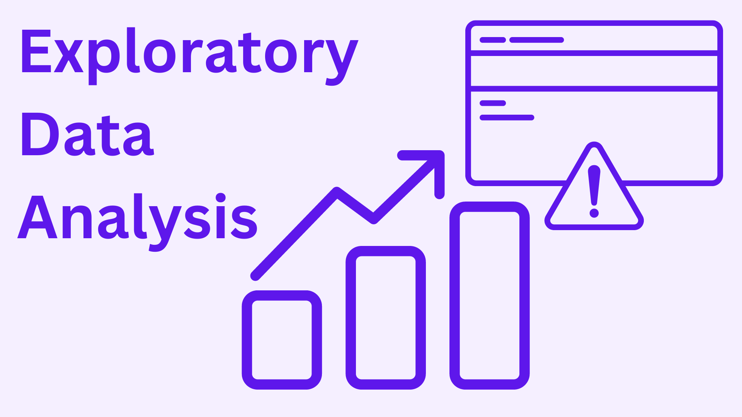
Recap
Till now we have :
Created An EDA to explore the dataset
Created A Medallion architecture Data warehouse
Dealt with encoding error in bronze layer
Dealt with nulls and duplicates and inconsistent data in silver layer
Represented data in a star schema in gold layer
The star schema is as :Fact_sales,Dim_customer,Dim_product
Next: We have to understand business goals

Slide 19
Building a second eda using sql
This EDA will help us understand the various business goals involved in data analysis.
The first EDA was for understanding the structure of raw data.
Through advanced querying,we can understand the ranks,important metrics and ranks etc.

Slide 20
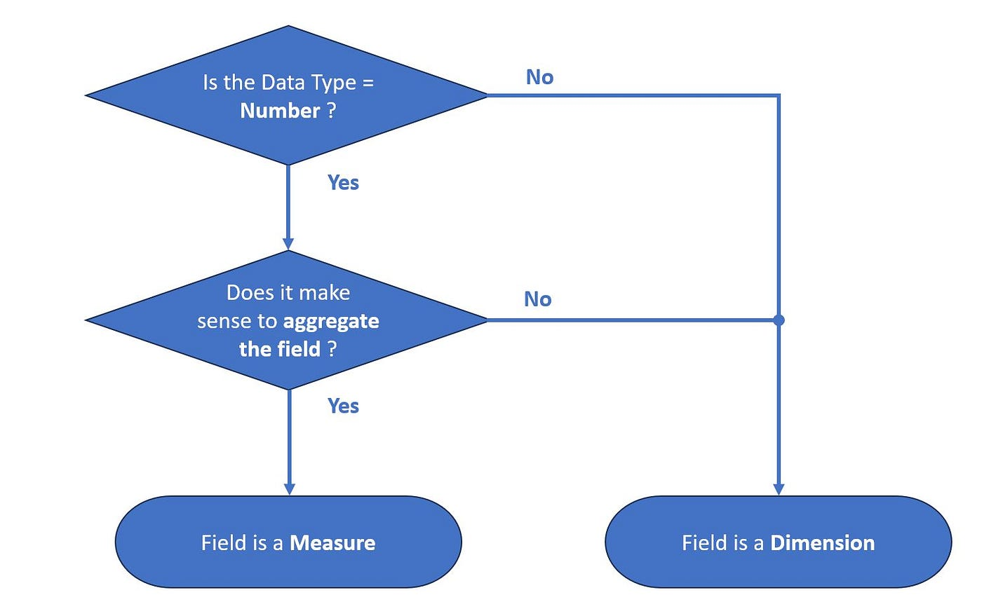
Understanding business goals
To visualize business goals we need to understand what is a dimension and what is a measure.
A dimension is a descriptive attribute or categorical variable used to slice, group, or filter data.
A measure is a numeric value that you can aggregate (sum, average, count, etc.). It's the "how much" or "how many" part of the data.
Dimension examples-Product_id ,cust_id,country,data
Measure-Sales,Price,Age

Slide 21

Step 1: Database exploration
USE RETAIL_DATA_WAREHOUSE;
To view all tables
SELECT * FROM INFORMATION_SCHEMA.TABLES
To view METADATA of columns from specific tables
SELECT * FROM INFORMATION_SCHEMA.COLUMNS WHERE TABLE_NAME='DIM_CUSTOMER';
SELECT * FROM INFORMATION_SCHEMA.COLUMNS WHERE TABLE_NAME='DIM_PRODUCT';
SELECT * FROM INFORMATION_SCHEMA.COLUMNS WHERE TABLE_NAME='FACT_SALES_EXTENDED';

Slide 22
Dimensions Explorations
A Simple file used to view columns.
We shall get into more advanced queries next.
SELECT DISTINCT CUSTOMER_COUNTRY FROM GOLD.DIM_CUSTOMER;
SELECT DISTINCT PRODUCT_CAT FROM GOLD.DIM_PRODUCT;
SELECT DISTINCT CUSTOMER_COUNTRY,CUSTOMER_STATE,CUSTOMER_CITY FROM GOLD.DIM_CUSTOMER;
SELECT PRODUCT_CAT,PRODUCT_BRAND,PRODUCTS FROM GOLD.DIM_PRODUCT ORDER BY 1,2,3;

Slide 23

Date Exploration
Used to explore Dates.
Identify latest and earliest dates
SELECT TRANSACTION_DATE FROM GOLD.FACT_SALES_EXTENDED;
SELECT MIN(TRANSACTION_DATE) AS FIRST_ORDER_DATE,MAX(TRANSACTION_DATE) AS LAST_ORDER_DATE FROM GOLD.FACT_SALES_EXTENDED;
SELECT DATEDIFF(year,MIN(TRANSACTION_DATE),MAX(TRANSACTION_DATE)) AS NO_OF_YEARS FROM GOLD.FACT_SALES_EXTENDED;

Slide 24
Date Exploration
Identify Youngest and Oldest Customers
SELECT TRANSACTION_DATE FROM GOLD.FACT_SALES_EXTENDED;
SELECT MIN(TRANSACTION_DATE) AS FIRST_ORDER_DATE,MAX(TRANSACTION_DATE) AS LAST_ORDER_DATE FROM GOLD.FACT_SALES_EXTENDED;
SELECT DATEDIFF(year,MIN(TRANSACTION_DATE),MAX(TRANSACTION_DATE)) AS NO_OF_YEARS FROM GOLD.FACT_SALES_EXTENDED;
SELECT CUSTOMER_NAME,CUSTOMER_AGE FROM GOLD.FACT_SALES_EXTENDED WHERE CUSTOMER_AGE=(
SELECT MIN(CUSTOMER_AGE) FROM GOLD.FACT_SALES_EXTENDED WHERE CUSTOMER_AGE!= 0);
SELECT CUSTOMER_NAME,CUSTOMER_AGE FROM GOLD.FACT_SALES_EXTENDED WHERE CUSTOMER_AGE=( SELECT MAX(CUSTOMER_AGE) FROM GOLD.FACT_SALES_EXTENDED);

Slide 25
Measures Explorations
Help us see the important metrics in a business
SELECT 'Total sales' AS measure_name,SUM(TOTAL_AMOUNT) AS measure_value FROM GOLD.FACT_SALES_EXTENDED
UNION ALL
SELECT 'Average sale', AVG(TOTAL_AMOUNT) FROM GOLD.FACT_SALES_EXTENDED
UNION ALL
SELECT 'Total purchases', SUM(CUSTOMER_PURCHASES) FROM GOLD.FACT_SALES_EXTENDED
UNION ALL
SELECT 'Total categories', COUNT( DISTINCT PRODUCT_CAT) FROM GOLD.FACT_SALES_EXTENDED
UNION ALL
SELECT'Total cities', COUNT(DISTINCT CUSTOMER_CITY) FROM GOLD.FACT_SALES_EXTENDED
UNION ALL
SELECT 'Total brands' ,COUNT(DISTINCT PRODUCT_BRAND) FROM GOLD.FACT_SALES_EXTENDED
UNION ALL
SELECT 'Total customers' ,COUNT(DISTINCT CUSTOMER_NAME) FROM GOLD.FACT_SALES_EXTENDED;

Slide 26
Magnitude Exploration
This section consists of complicated queries involving joins.
Helps us visualize data throughout
Example
Average revenue per category
SELECT P.PRODUCT_CAT,AVG(F.TRANSACTION_AMOUNT) AS AVERAGE_REVENUE
FROM GOLD.FACT_SALES_EXTENDED F
JOIN GOLD.DIM_PRODUCT P
ON F.PRODUCT_ID=P.PRODUCT_ID
GROUP BY P.PRODUCT_CAT

Slide 27
Magnitude Exploration
Another example is Total Revenue per country
SELECT
sum(F.TRANSACTION_AMOUNT) AS REVENUE,
C.CUSTOMER_COUNTRY
FROM GOLD.FACT_SALES_EXTENDED F
JOIN GOLD.DIM_CUSTOMER C
ON F.CUSTOMER_ID=C.CUSTOMER_ID
GROUP BY C.CUSTOMER_COUNTRY

Slide 28
Ranking
Used to Rank measures .
Allows us to see the top and bottom values
Example:
FOR TOP 5 PRODUCTS IN REVENUE:
SELECT TOP 5
P.PRODUCTS,
SUM(F.TOTAL_AMOUNT) AS REVENUE,
ROW_NUMBER() OVER (ORDER BY SUM(F.TOTAL_AMOUNT) DESC ) AS RANK
FROM GOLD.FACT_SALES_EXTENDED F
JOIN GOLD.DIM_PRODUCT P
ON F.PRODUCT_ID=P.PRODUCT_ID
GROUP BY P.PRODUCTS
ORDER BY REVENUE DESC;

Slide 29
Ranking
For top 5 customers
SELECT TOP 5
C.CUSTOMER_ID,
SUM(F.TOTAL_AMOUNT) AS REVENUE
FROM GOLD.FACT_SALES_EXTENDED F
JOIN GOLD.DIM_CUSTOMER C
ON F.CUSTOMER_ID=C.CUSTOMER_ID
GROUP BY C.CUSTOMER_ID
ORDER BY REVENUE DESC

